Slide 1
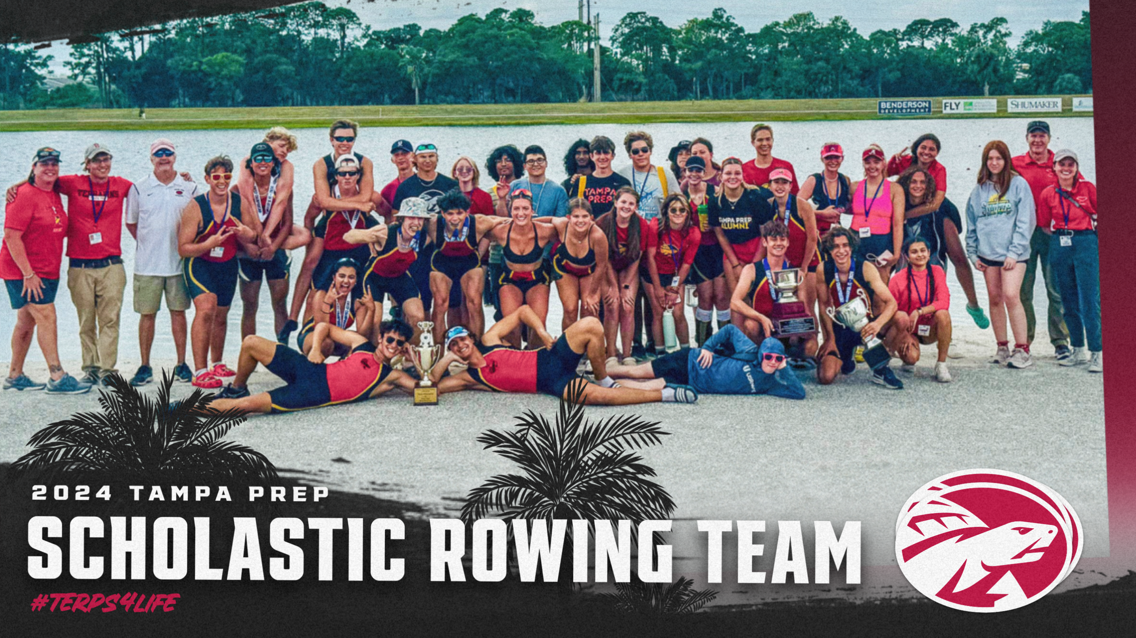
TAMPA PREP ROWING EOY BANQUET
Thursday, May 2, 2024

Slide 2
AGENDA
Welcome/Opening Remarks by Raj Kotak
Dinner & Show
Senior Recognition by Raj Kotak
Coach Recognition by Raj Kotak
Speakers by Team Captain/Senior Athlete
Awards Presentation by Coach Chris
Closing Remarks by Raj Kotak and Coach Chris
Thank you!

Slide 3
WELCOME!
Opening Remarks: Raj
In honor of our rowers, coxswains, equipment managers, and coaching staff’s outstanding accomplishments.
It’s time to celebrate 2023-2024 season!

Slide 4
INTRODUCTION TO TAMPA PREP ROWING
Coaching Staff
Head Coach – Chris VanDyck
Assistant Coach – Cassidy Bull
Assistant Coach – Annie Otto
Ters4Life Volunteer Coach – Jim Preston
Ters4Life Parent Volunteer Coaches - Jennifer Mook & Andrew Findlay
Rowing Parent Leadership
Presidents: Allison & Jennifer Mook (Raj Kotak: ‘2024-’2025)
Communications Director: Erin Bohacek (INDEF)
Treasurer – Lisa Loosbrock (Deb & Spencer Dille: ‘2024-’2025)
Hospitality – Andrew Findlay (Wally Glowicki: ‘2024-’2025)
Hospitality – Kim McGivern (Nurdan Johnsingh & Kim McGivern: ‘2024-’2025)

Slide 5
INTRODUCTION TO TAMPA PREP ROWING (Cont’d)
Rowing Sub Committees
Boat Trailering – Coach Jen, Coach Chris, Coach Cassidy / ‘24-’25 Accepting Application!
Team Gear: Melissa Messer
Team Photographer: Karina Findlay / ‘24-’25 VACANT
Regatta Travel Coordinator: ‘24-’25 VACANT
Regatta Transportation Coordinator: ‘24-’25VACANT
Regatta Shoppers: Tricia Powers & Erin Cowan
Regatta Runner: Chuck Powers
Regatta Food Prep & Bakers: Nurdan Johnsingh, Deb Deille, Kim McGivern, Corrie Herrmann, Shelby Scheonborn, Allison Mook, Erin Bohacek, Melissa Messer
Chaperones: Erin Bohacek, Nancy Lawler, Kim McGivern, Tricia & Chuck Powers, Allison & Jen Mook, Raj & Tanuja Kotak, Christina Burden, Allison Burden, Wally & Mackenzie Glowicki, Erin Cowan, Stephanie Fry, Deb & Spencer Dille
FSRA Volunteers (saved us $250/slot): Allison & Jen Mook, Andrew Findlay, Cindy Schwarzkopt, Erin Bohacek, Melissa Messer, Deb Dille, Laura Marcia & Herman Maldonado, Julie Webster, Stephanie Fry
EOY Banquet Committee: Cindy Schwarzkopf & Selina O’Shannon

Slide 6
Hospitality Team Tent Process
Menu Creation, Shopping & Prepping – A week before the event
Chuck Wagon Master - restock fuel, ice/water and drive to the venue a day prior to the event, carefully selects/reserves/parks, apply insecticide
Tent Set Up - tent, tarp, table setup along with grilling
Cooking/Grilling - none stop operation to cook breakfast and lunch
FEAST - it’s a long day family event that rowers, coxswains, equipment managers, coaching staff, parents, grandparents, siblings, friends are welcome to join
Tear Down & Pack Up – all team parents are welcome to join us in this process
Chuck Wagon Master – heads back to the mothership

Slide 7
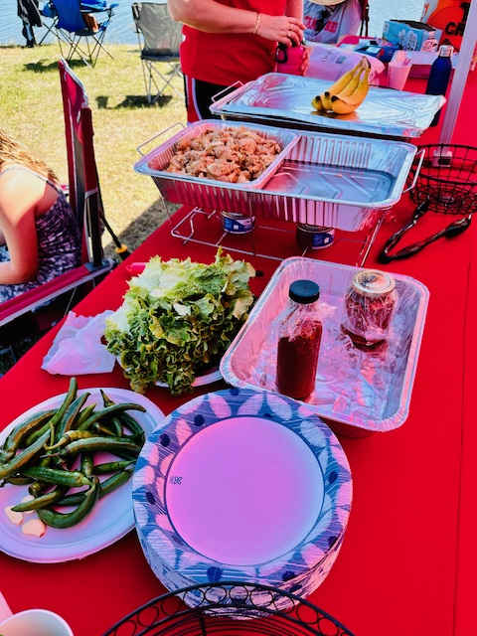
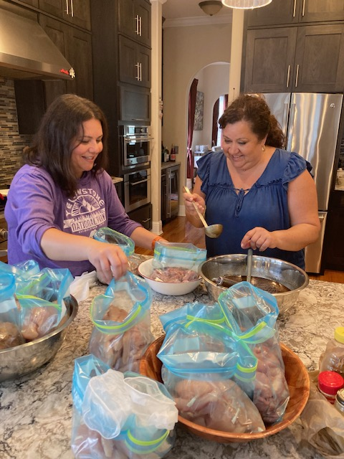
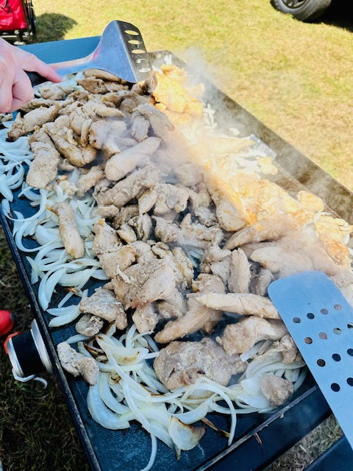
Highlights from ‘2023-’2024

Slide 8
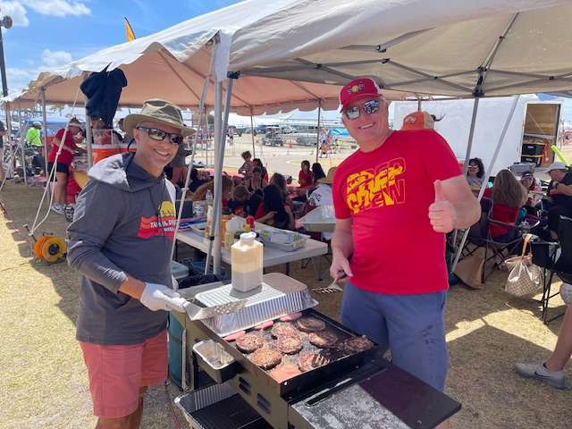
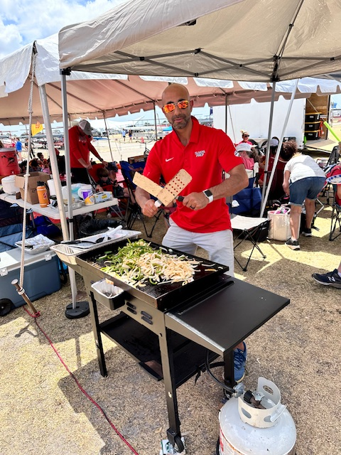
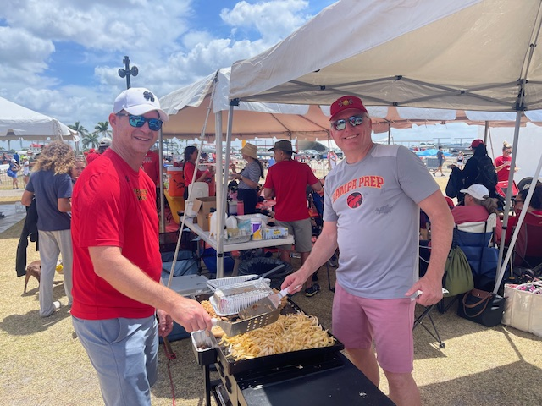
Highlights from ‘2023-’2024

Slide 9
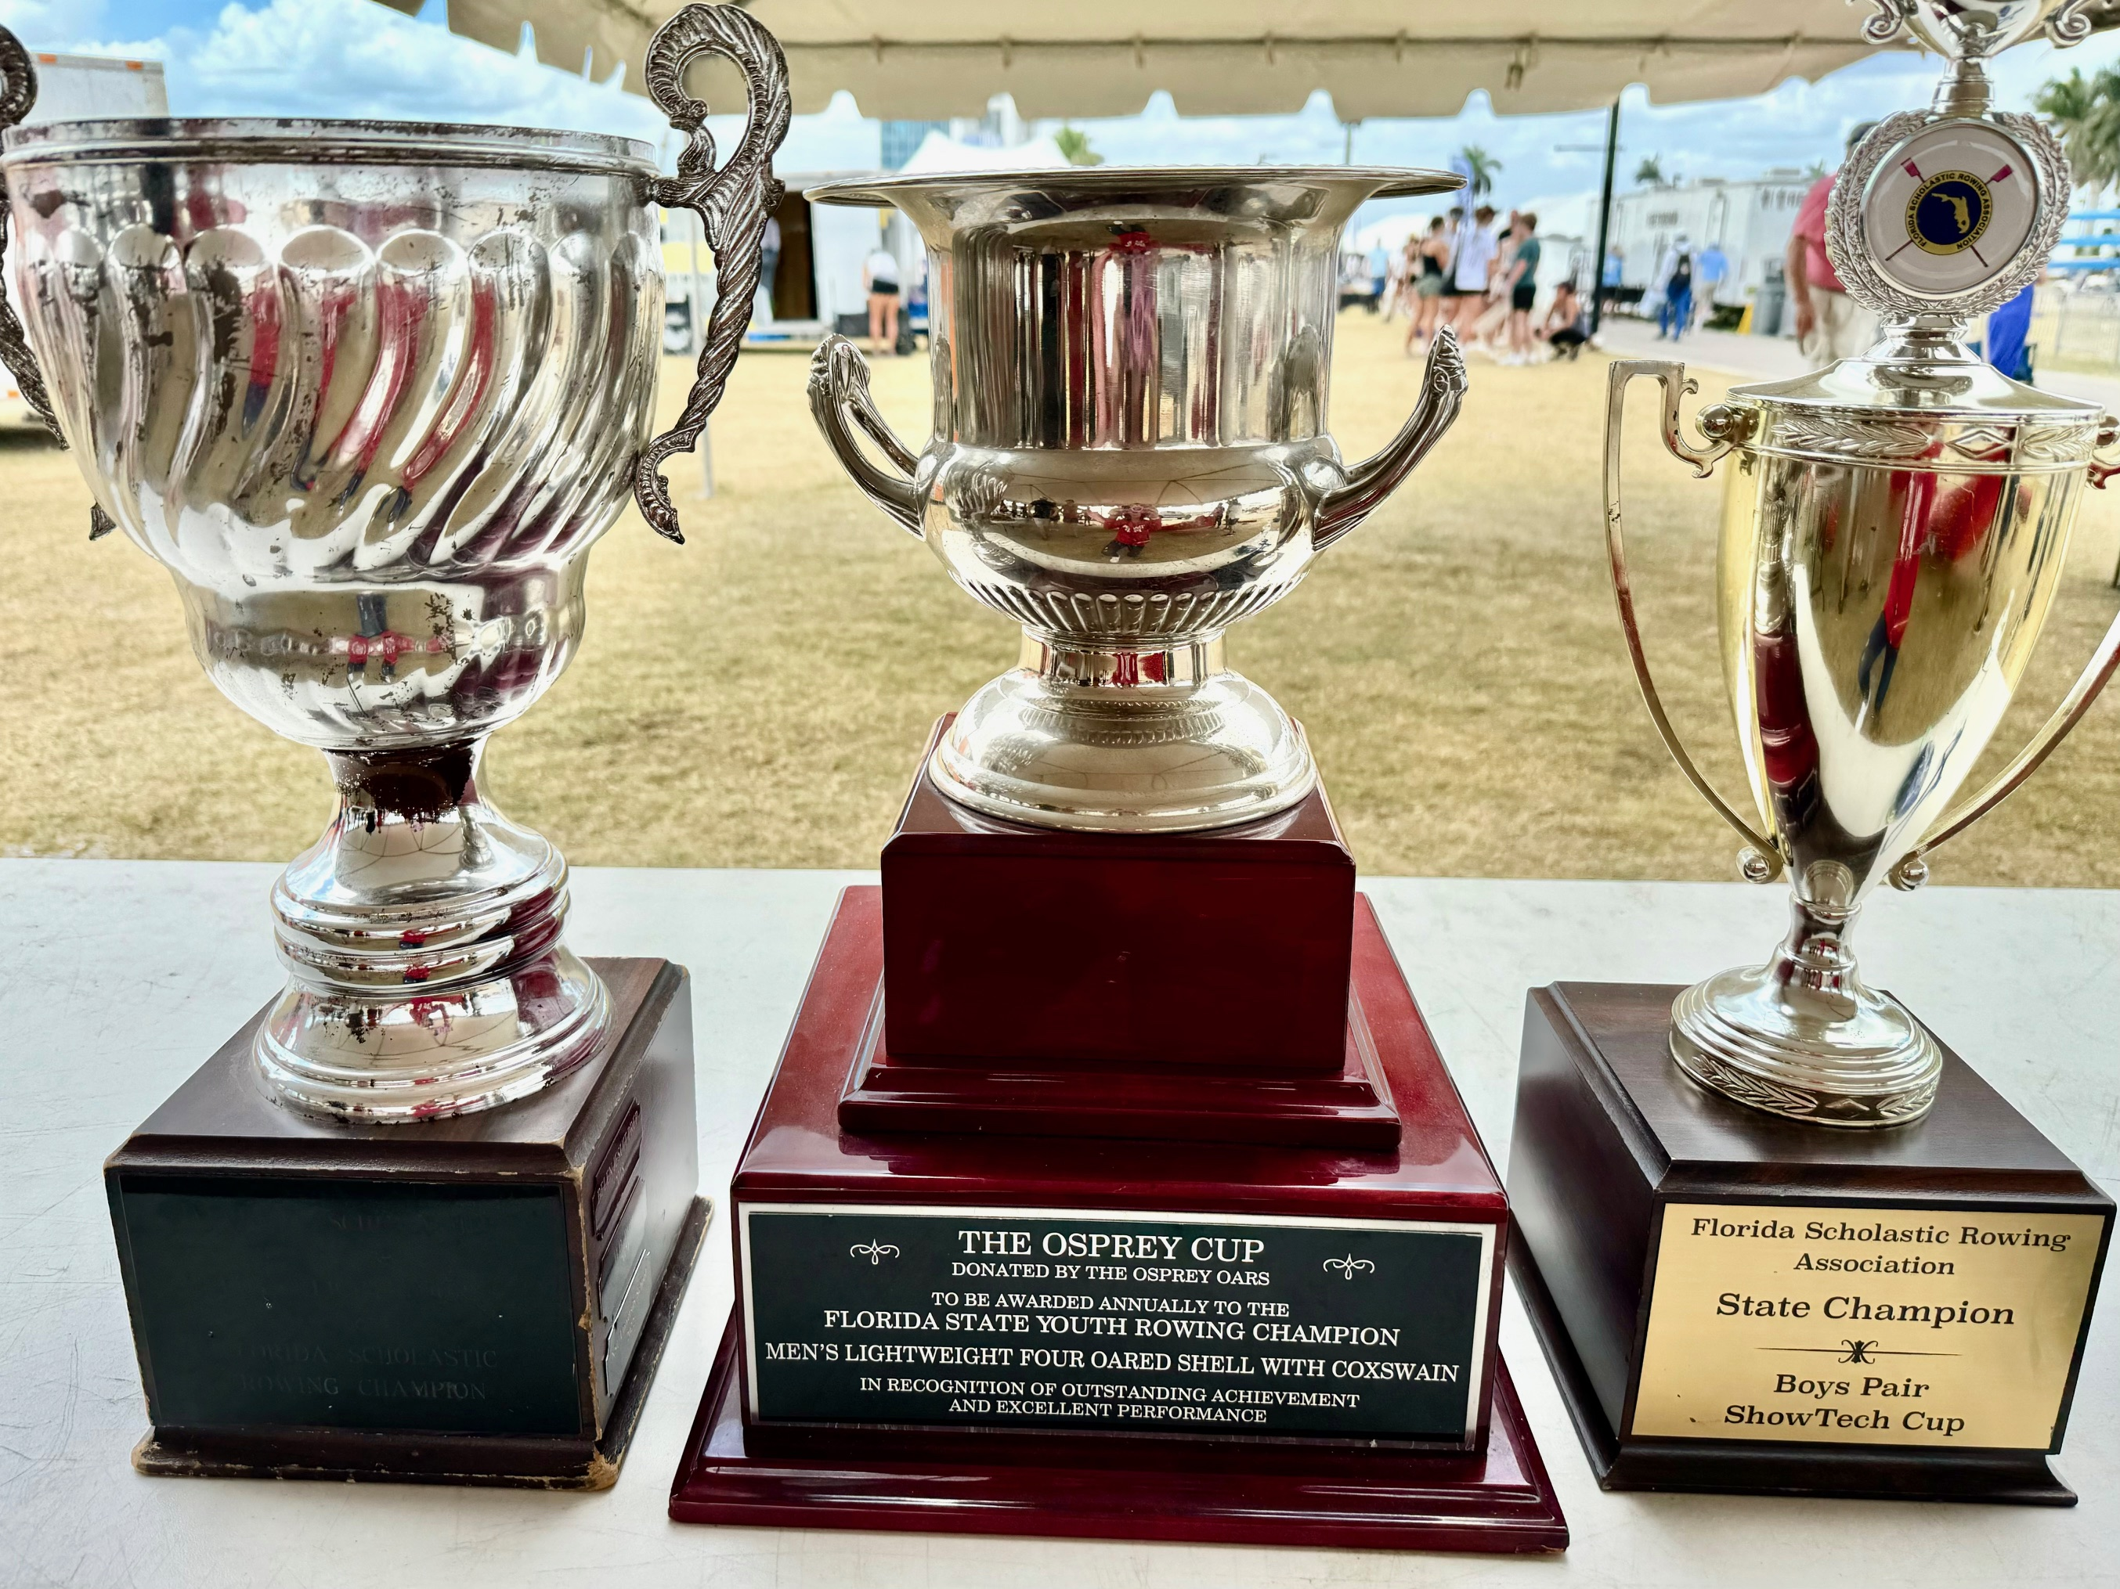
Highlights from ‘2023-’2024
For the month of April, the team has consumed: ~120 lbs. of chicken
~45 lbs. of rice
~300 burger patties along with other regatta food items.

